Slide 1
TEST DRIVEN DEVELOPMENT (TDD)

Slide 2

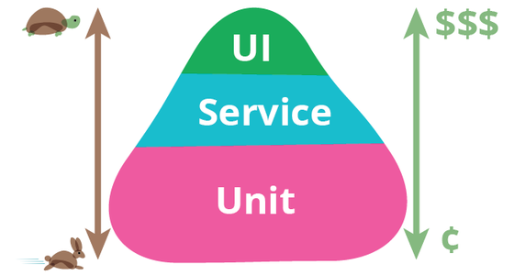
PUMP THE BREAKS - LETS TALK TESTING FIRST
Different types of testing – unit, integration/service, functional/UI
Write lots of unit tests, write few hot path UI tests

Slide 3
WHY SHOULD WE UNIT TEST?
Break down our program into discrete testable behaviors that we can test as units.
Less time performing tests higher on the pyramid
Protection against regression
Executable documentation
Less coupled code

Slide 4

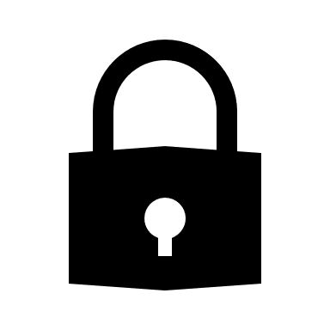
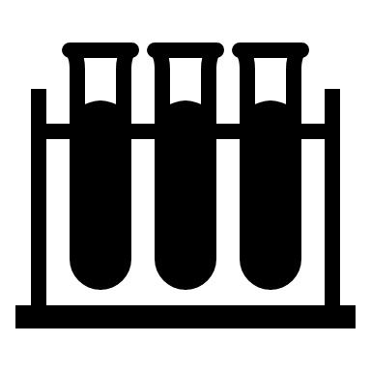
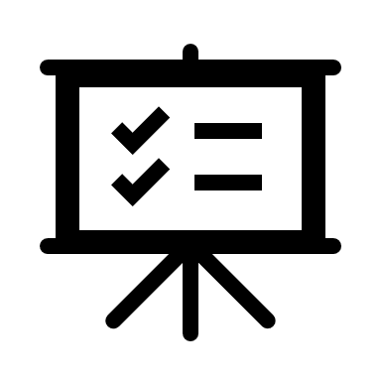
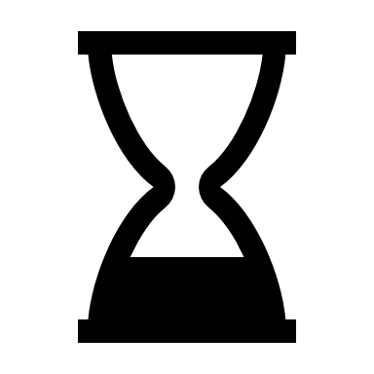
WHAT MAKES A GOOD UNIT TEST?
Fast – extremely fast. Milliseconds. Mature projects have thousands of unit tests.
Isolated - can be run in isolation and have no dependencies on any outside factors (database, file system)
Repeatable - running a unit test should have the same results every time you run it
Self-Checking - the test should be able to automatically detect a pass or failure
Timely - should not take a disproportionately long time to write compared to the production code being written - consider reworking the design

Slide 5
WHAT NOT TO TEST
External APIs – these must be assumed to be working
Trivial tests
Constructors or properties that just return variables
Exception messages
POCO classes
Facades wrapping other frameworks or libraries
Private methods
Making a private method internal so it can be tested can sometimes be a smell

Slide 6
WHAT IS TDD?
Software requirements are converted to test cases before software is fully developed
Interweaves coding, testing and design into one activity
Proven technique for improving and debugging legacy code with older techniques
Notes:
Can be by a QA engineer alongside a developer, two developers (or more developers), or even just a single developer. I’ll get into some techniques I like to employ when test-driving the code I write.

Slide 7



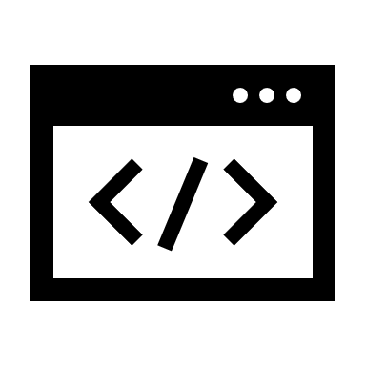
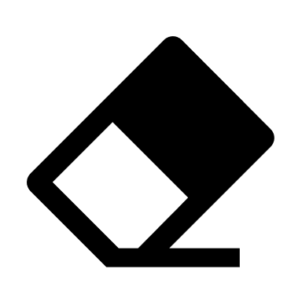
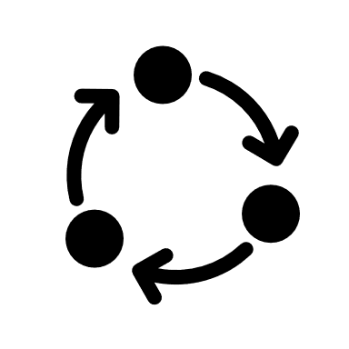
THE BENEFITS
Helps maintain a sustainable pace
Reduces cycle time when a bug arises
Code-as-documentation
Helps create designs that conform to coding principles
Makes refactors a lot easier
And on and on and on…

Slide 8


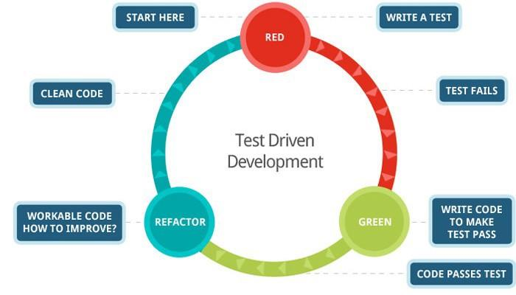
Notes:
RED
Writes the test that brings ‘order’ to the application by placing constraints on the application from the business rules.
The test will fail because the production code is not yet written.
GREEN
Writes the minimum amount of production code to make the test pass. Im serious, the minimum. We are only concerned with getting the test to the green state.
“Quick and dirty” is okay here. We want to make our cycle time from red to green as short as possible.
REFACTOR
Refactor the production code that was written.
Immediately commit the code - we want to be able to walk back any further changes in case things go in a direction Harmony doesn’t like.
Because the test is green, changing the quick and dirty solution into a clean and elegant solution is really easy. The test can be rerun to make sure it still (and other tests) does what we programmed it to do.

Slide 9
THE FIZZBUZZ PROBLEM
Print the numbers 1 to 100.
If given a number divisible by three, the program should return the word “Fizz”. 3, 6, 9, ETC.
If given a number divisible by five, the program should return the word “Buzz” 5, 10, ETC.
If given a number divisible by both three and five, the program should return the word “FizzBuzz”. 15, 30, 45, ETC.
Otherwise, just return the number itself. 1, 2, 4, 6, ETC.

Slide 10

THE LIVE DEMO

Slide 11
FURTHER YOUR MASTERY
Microsoft best practices
Test Driven Development: By Example (Book)
C# & .NET Core Test Driven Development (Book)
Working Effectively with Legacy Code (Book)
Unit Testing for C# Developers (Udemy)

Slide 12
CLOSING THOUGHTS
It’s okay to walk instead of run with TDD
Tests that are written with production code, then writing the tests are better than no tests at all
Get a feel for it and then slowly try flipping the process on its head

